Slide 1
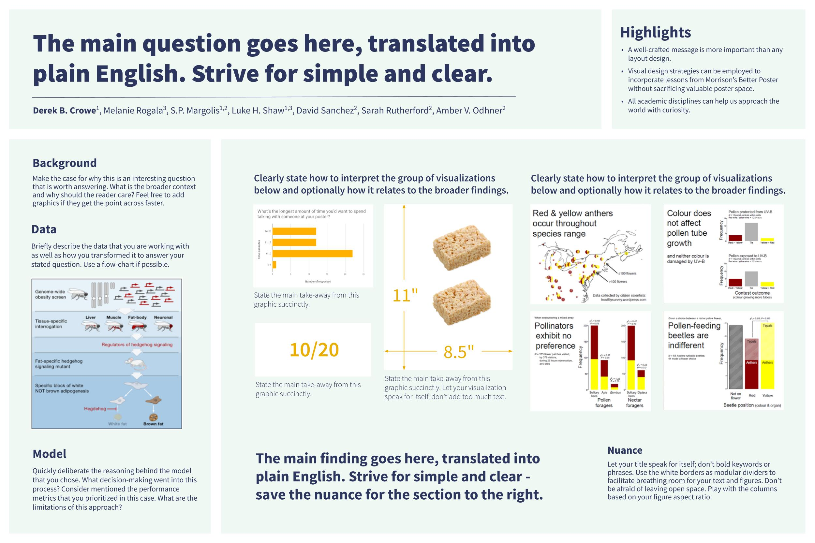
The Datafolio is a visual snapshot of a data project.
It’s designed to
highlight your data storytelling skills
quickly convey the gist of your project
be accessible to non-technical audiences

Slide 2
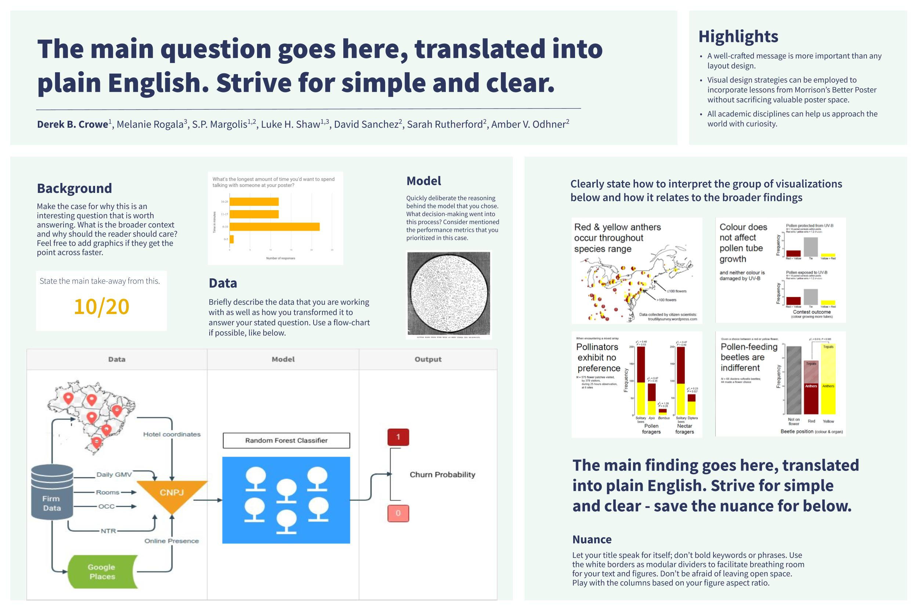
Data projects differ greatly and a one size fits all template cannot capture them all. Instead, we provide different starting points that reflect distinct types of projects.
Emphasis on EDA and results.
Emphasis on data and model.

Slide 3
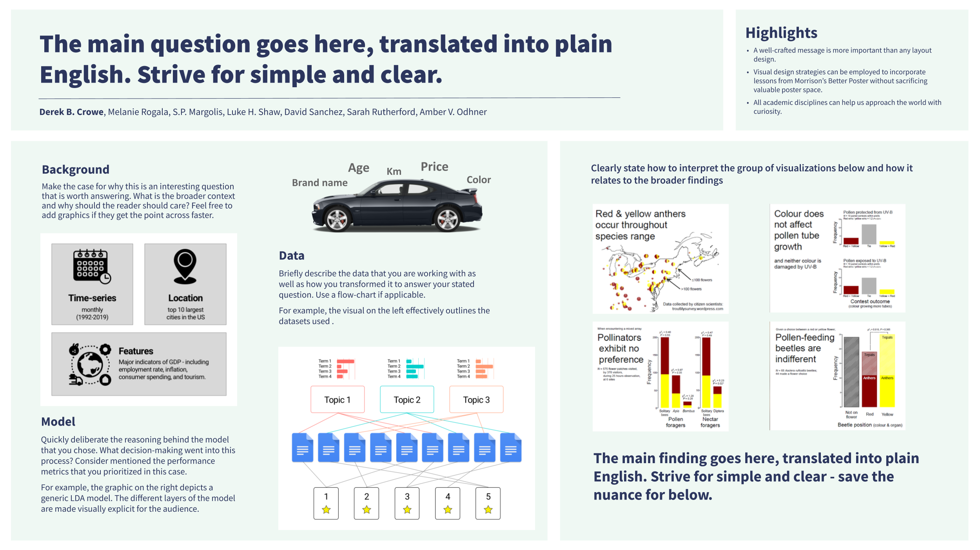
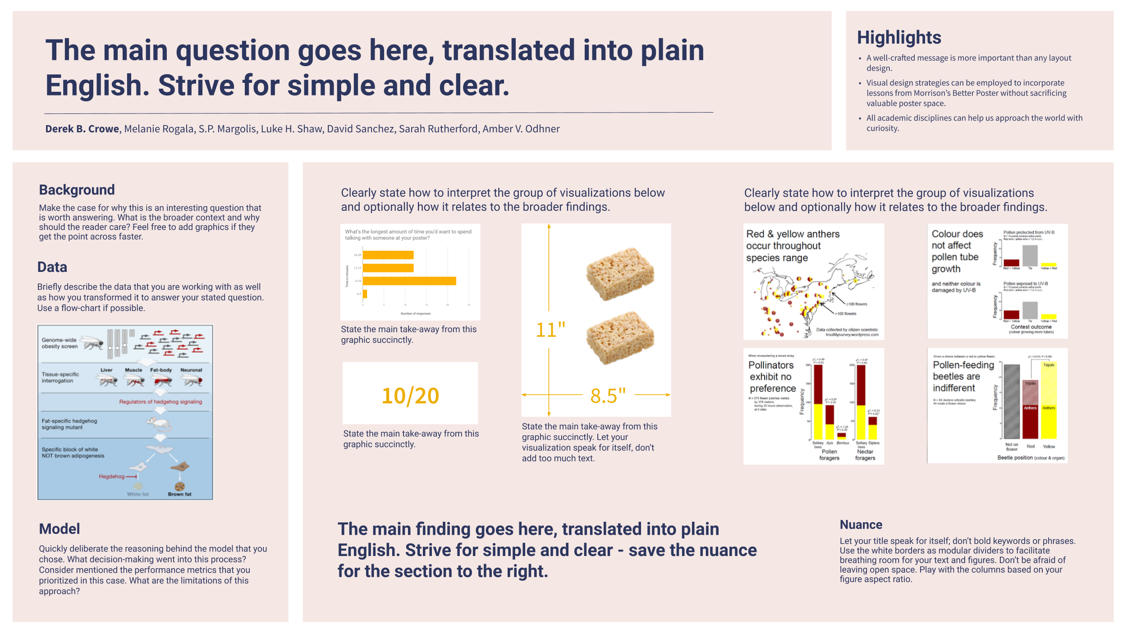
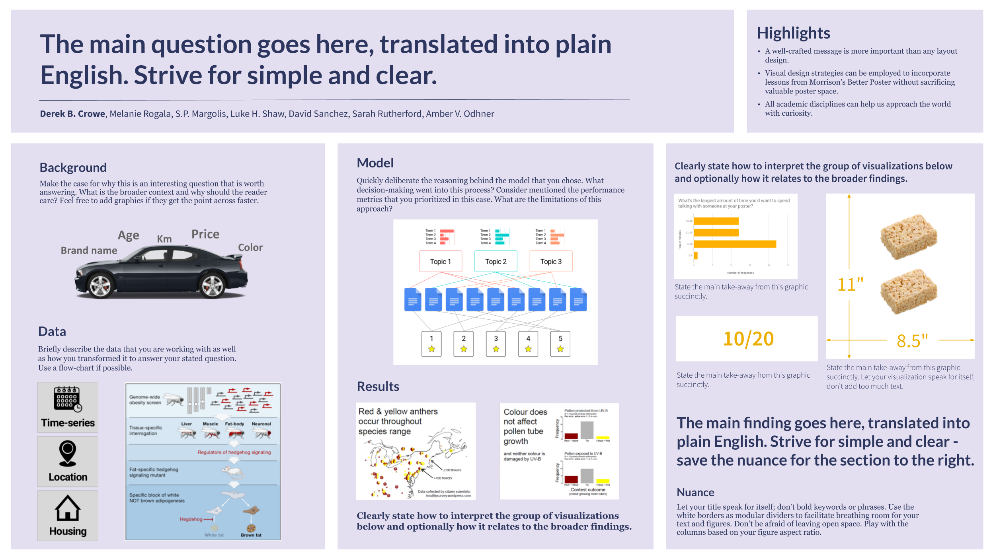
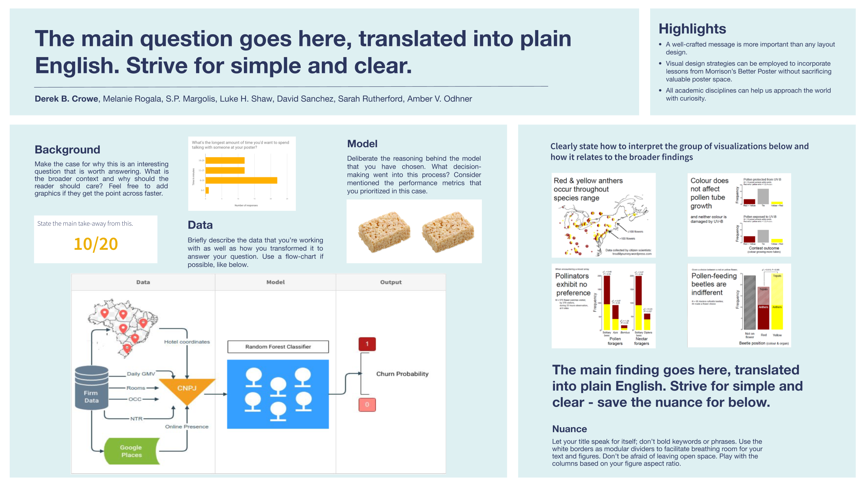
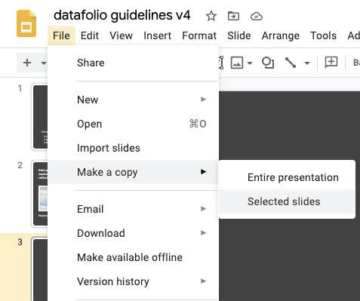
How to create a datafolio
Browse through the four starting points (slides 4-7) and choose the most appropriate one for your project.
Once you’ve decided on a starting point, select that slide and make a local copy.
We recommend that you edit directly on Google Slides (especially if you are collaborating with others)
Once you are done, export as a PDF or image (File -> Download -> as PDF/JPG/PNG)

Slide 4
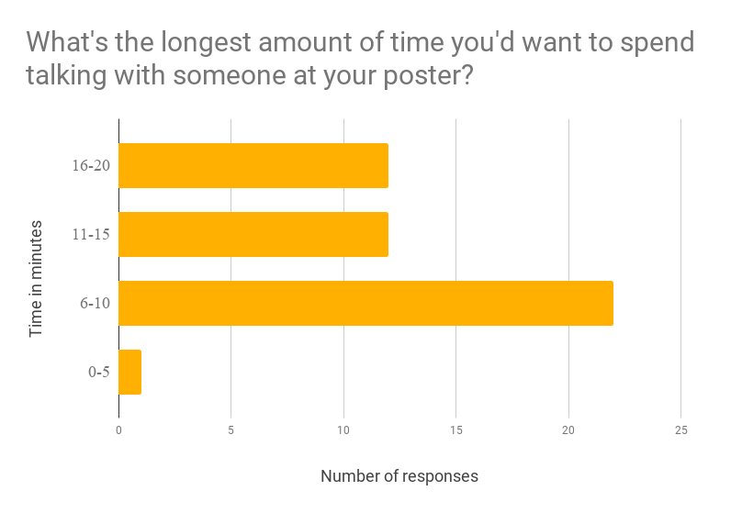
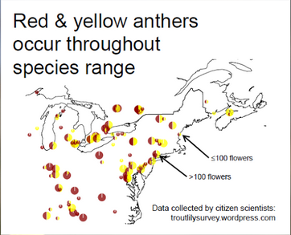
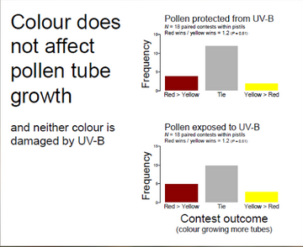
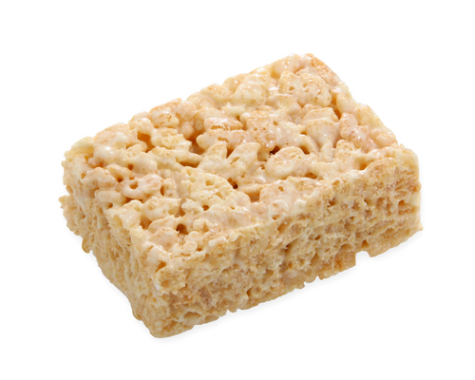
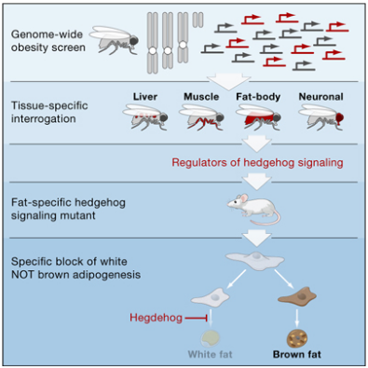
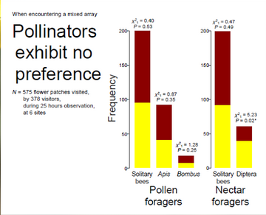
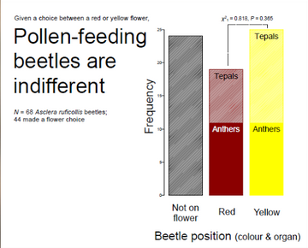
The main question goes here, translated into plain English. Strive for simple and clear.
Highlights
A well-crafted message is more important than any layout design.
Visual design strategies can be employed to incorporate lessons from Morrison’s Better Poster without sacrificing valuable poster space.
All academic disciplines can help us approach the world with curiosity.
Derek B. Crowe, Melanie Rogala, S.P. Margolis, Luke H. Shaw, David Sanchez, Sarah Rutherford, Amber V. Odhner
Background
Make the case for why this is an interesting question that is worth answering. What is the broader context and why should the reader care? Feel free to add graphics if they get the point across faster.
Clearly state how to interpret the group of visualizations below and optionally how it relates to the broader findings.
Clearly state how to interpret the group of visualizations below and optionally how it relates to the broader findings.
Data
Briefly describe the data that you are working with as well as how you transformed it to answer your stated question. Use a flow-chart if possible.
State the main take-away from this graphic succinctly.
11"
10/20
8.5"
State the main take-away from this graphic succinctly.
State the main take-away from this graphic succinctly. Let your visualization speak for itself, don’t add too much text.
Model
Quickly deliberate the reasoning behind the model that you chose. What decision-making went into this process? Consider mentioned the performance metrics that you prioritized in this case. What are the limitations of this approach?
The main finding goes here, translated into plain English. Strive for simple and clear - save the nuance for the section to the right.
Nuance
Let your title speak for itself; don’t bold keywords or phrases. Use the white borders as modular dividers to facilitate breathing room for your text and figures. Don’t be afraid of leaving open space. Play with the columns based on your figure aspect ratio.

Slide 5
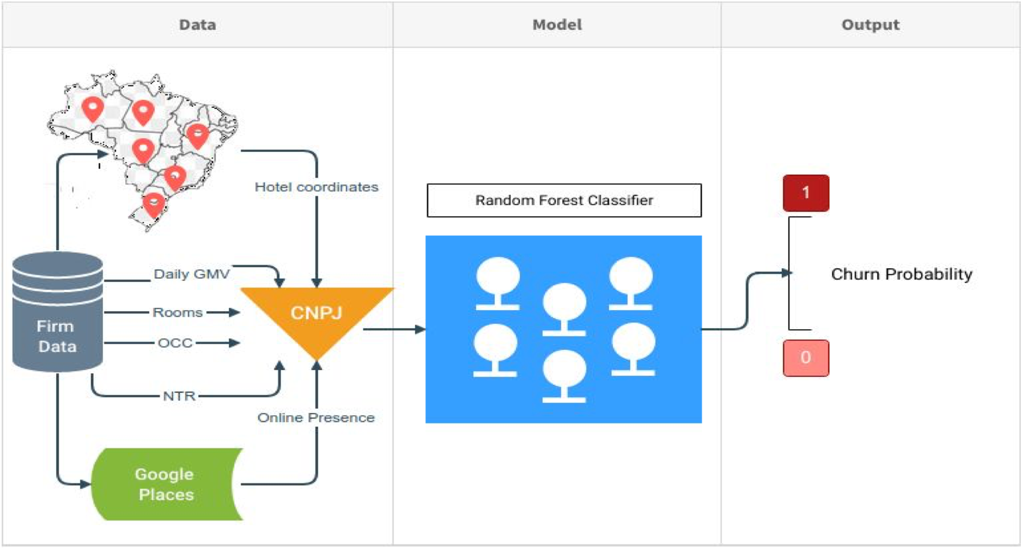
The main question goes here, translated into plain English. Strive for simple and clear.
Highlights
A well-crafted message is more important than any layout design.
Visual design strategies can be employed to incorporate lessons from Morrison’s Better Poster without sacrificing valuable poster space.
All academic disciplines can help us approach the world with curiosity.
Derek B. Crowe, Melanie Rogala, S.P. Margolis, Luke H. Shaw, David Sanchez, Sarah Rutherford, Amber V. Odhner
Background
Make the case for why this is an interesting question that is worth answering. What is the broader context and why should the reader should care? Feel free to add graphics if they get the point across faster.
Model
Deliberate the reasoning behind the model that you have chosen. What decision- making went into this process? Consider mentioned the performance metrics that you prioritized in this case.
Clearly state how to interpret the group of visualizations below and how it relates to the broader findings
State the main take-away from this.
Data
Briefly describe the data that you’re working with as well as how you transformed it to answer your question. Use a flow-chart if possible, like below.
10/20
The main finding goes here, translated into plain English. Strive for simple and clear - save the nuance for below.
Nuance
Let your title speak for itself; don’t bold keywords or phrases. Use the white borders as modular dividers to facilitate breathing room for your text and figures. Don’t be afraid of leaving open space. Play with the columns based on your figure aspect ratio.

Slide 6
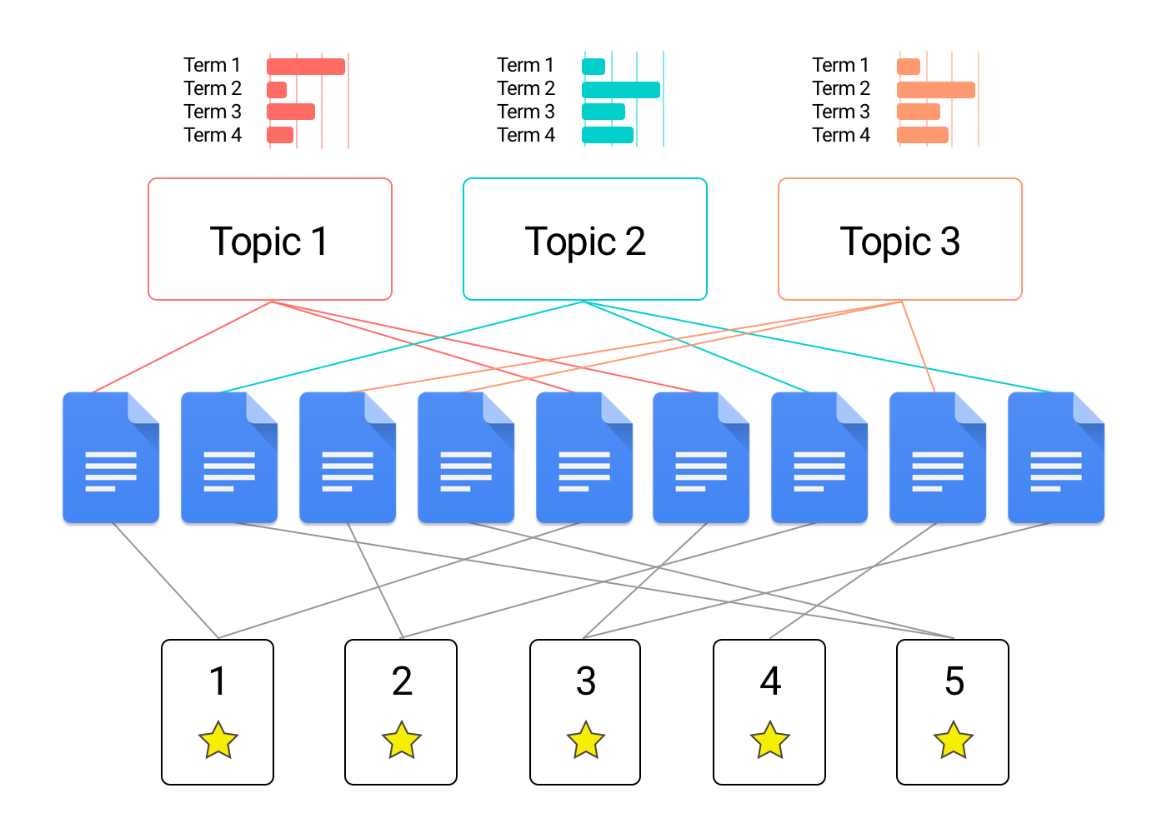
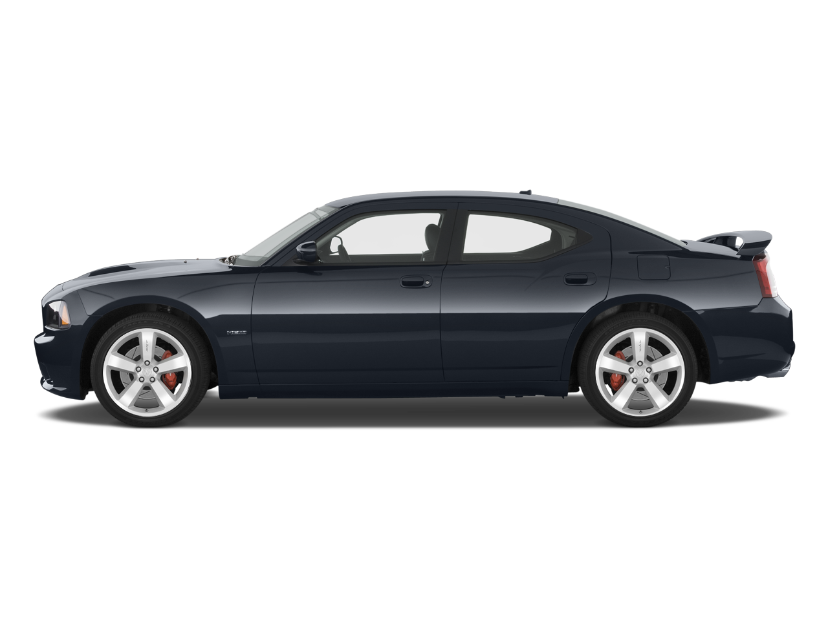

The main question goes here, translated into plain English. Strive for simple and clear.
Highlights
A well-crafted message is more important than any layout design.
Visual design strategies can be employed to incorporate lessons from Morrison’s Better Poster without sacrificing valuable poster space.
All academic disciplines can help us approach the world with curiosity.
Derek B. Crowe, Melanie Rogala, S.P. Margolis, Luke H. Shaw, David Sanchez, Sarah Rutherford, Amber V. Odhner
Background
Make the case for why this is an interesting question that is worth answering. What is the broader context and why should the reader care? Feel free to add graphics if they get the point across faster.
Model
Quickly deliberate the reasoning behind the model that you chose. What decision-making went into this process? Consider mentioned the performance metrics that you prioritized in this case. What are the limitations of this approach?
Clearly state how to interpret the group of visualizations below and optionally how it relates to the broader findings.
Age
Km
Price
Brand name
Color
State the main take-away from this graphic succinctly.
11"
Data
Briefly describe the data that you are working with as well as how you transformed it to answer your stated question. Use a flow-chart if possible.
10/20
8.5"
State the main take-away from this graphic succinctly.
State the main take-away from this graphic succinctly. Let your visualization speak for itself, don’t add too much text.
Results
The main finding goes here, translated into plain English. Strive for simple and clear - save the nuance for the section to the right.
Nuance
Let your title speak for itself; don’t bold keywords or phrases. Use the white borders as modular dividers to facilitate breathing room for your text and figures. Don’t be afraid of leaving open space. Play with the columns based on your figure aspect ratio.
Clearly state how to interpret the group of visualizations below and optionally how it relates to the broader findings.

Slide 7
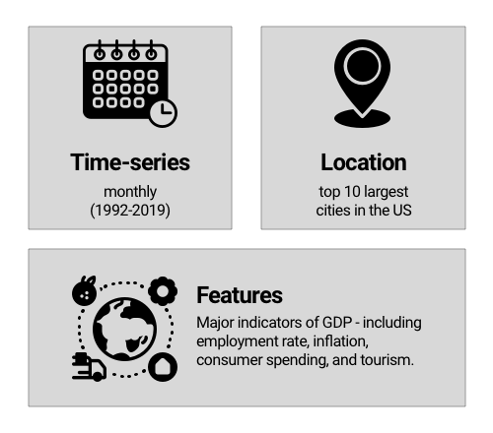
The main question goes here, translated into plain English. Strive for simple and clear.
Highlights
A well-crafted message is more important than any layout design.
Visual design strategies can be employed to incorporate lessons from Morrison’s Better Poster without sacrificing valuable poster space.
All academic disciplines can help us approach the world with curiosity.
Derek B. Crowe, Melanie Rogala, S.P. Margolis, Luke H. Shaw, David Sanchez, Sarah Rutherford, Amber V. Odhner
Background
Make the case for why this is an interesting question that is worth answering. What is the broader context and why should the reader should care? Feel free to add graphics if they get the point across faster.
Age
Km
Price
Clearly state how to interpret the group of visualizations below and how it relates to the broader findings
Brand name
Color
Data
Briefly describe the data that you are working with as well as how you transformed it to answer your stated question. Use a flow-chart if applicable.
For example, the visual on the left effectively outlines the datasets used .
Model
Quickly deliberate the reasoning behind the model that you chose. What decision-making went into this process? Consider mentioned the performance metrics that you prioritized in this case.
For example, the graphic on the right depicts a generic LDA model. The different layers of the model are made visually explicit for the audience.
The main finding goes here, translated into plain English. Strive for simple and clear - save the nuance for below.

Slide 8
Datafolio F.A.Q.
What should I avoid?
Cutting and pasting text from your write-up won’t work. You need to rethink your messaging for this format.
You won’t be able to fit everything in. You need to be selective about what to include in the datafolio.
How do I distill my project into just one page?
Informative graphics, flowcharts, and visualizations are both more engaging and condensed than text-based descriptions of your methods and results.
How do I get started?
Skim through your project and find one narrative or story that you want to tell.
Outline the main points that you want to convey, and use them to motivate the design of the datafolio.

Slide 9
Design Guideline
Color
Don’t have multiple colors. Stick to two at most and use their shades and tints. (ex: slide 10 & 13)
Make sure your background color isn’t overpowering your graphics and copy. Using a light color for the background usually helps (ex: slide 10, 12 & 13)
Fonts
Don’t have multiple fonts either. Stick to one/two fonts that are clean and not fancy or script. To test this, have 1 or 2 family or friends read it, and see if they take longer to read it compared to a font such as Arial or Roboto.
Remember that people will have to zoom into your datafolio, to read your copy, so having a clean font (ex: Roboto, Helvetica, Avenir, Open sans, Georgia, Lato etc) is very important.
Hierarchy is important. Your title should be the biggest font, followed by 2nd important title that should have the same size font depending on their level of importance (ex: Slide 10 - 13)
Other
It’s always good idea to have your infographics/charts a similar and deeper color as your background so it looks coherent and easy to read prestation (ex: slide 10 & 13).
Less is more!

Slide 10
Gallery
Real datafolios designed using the starting points.

Slide 11
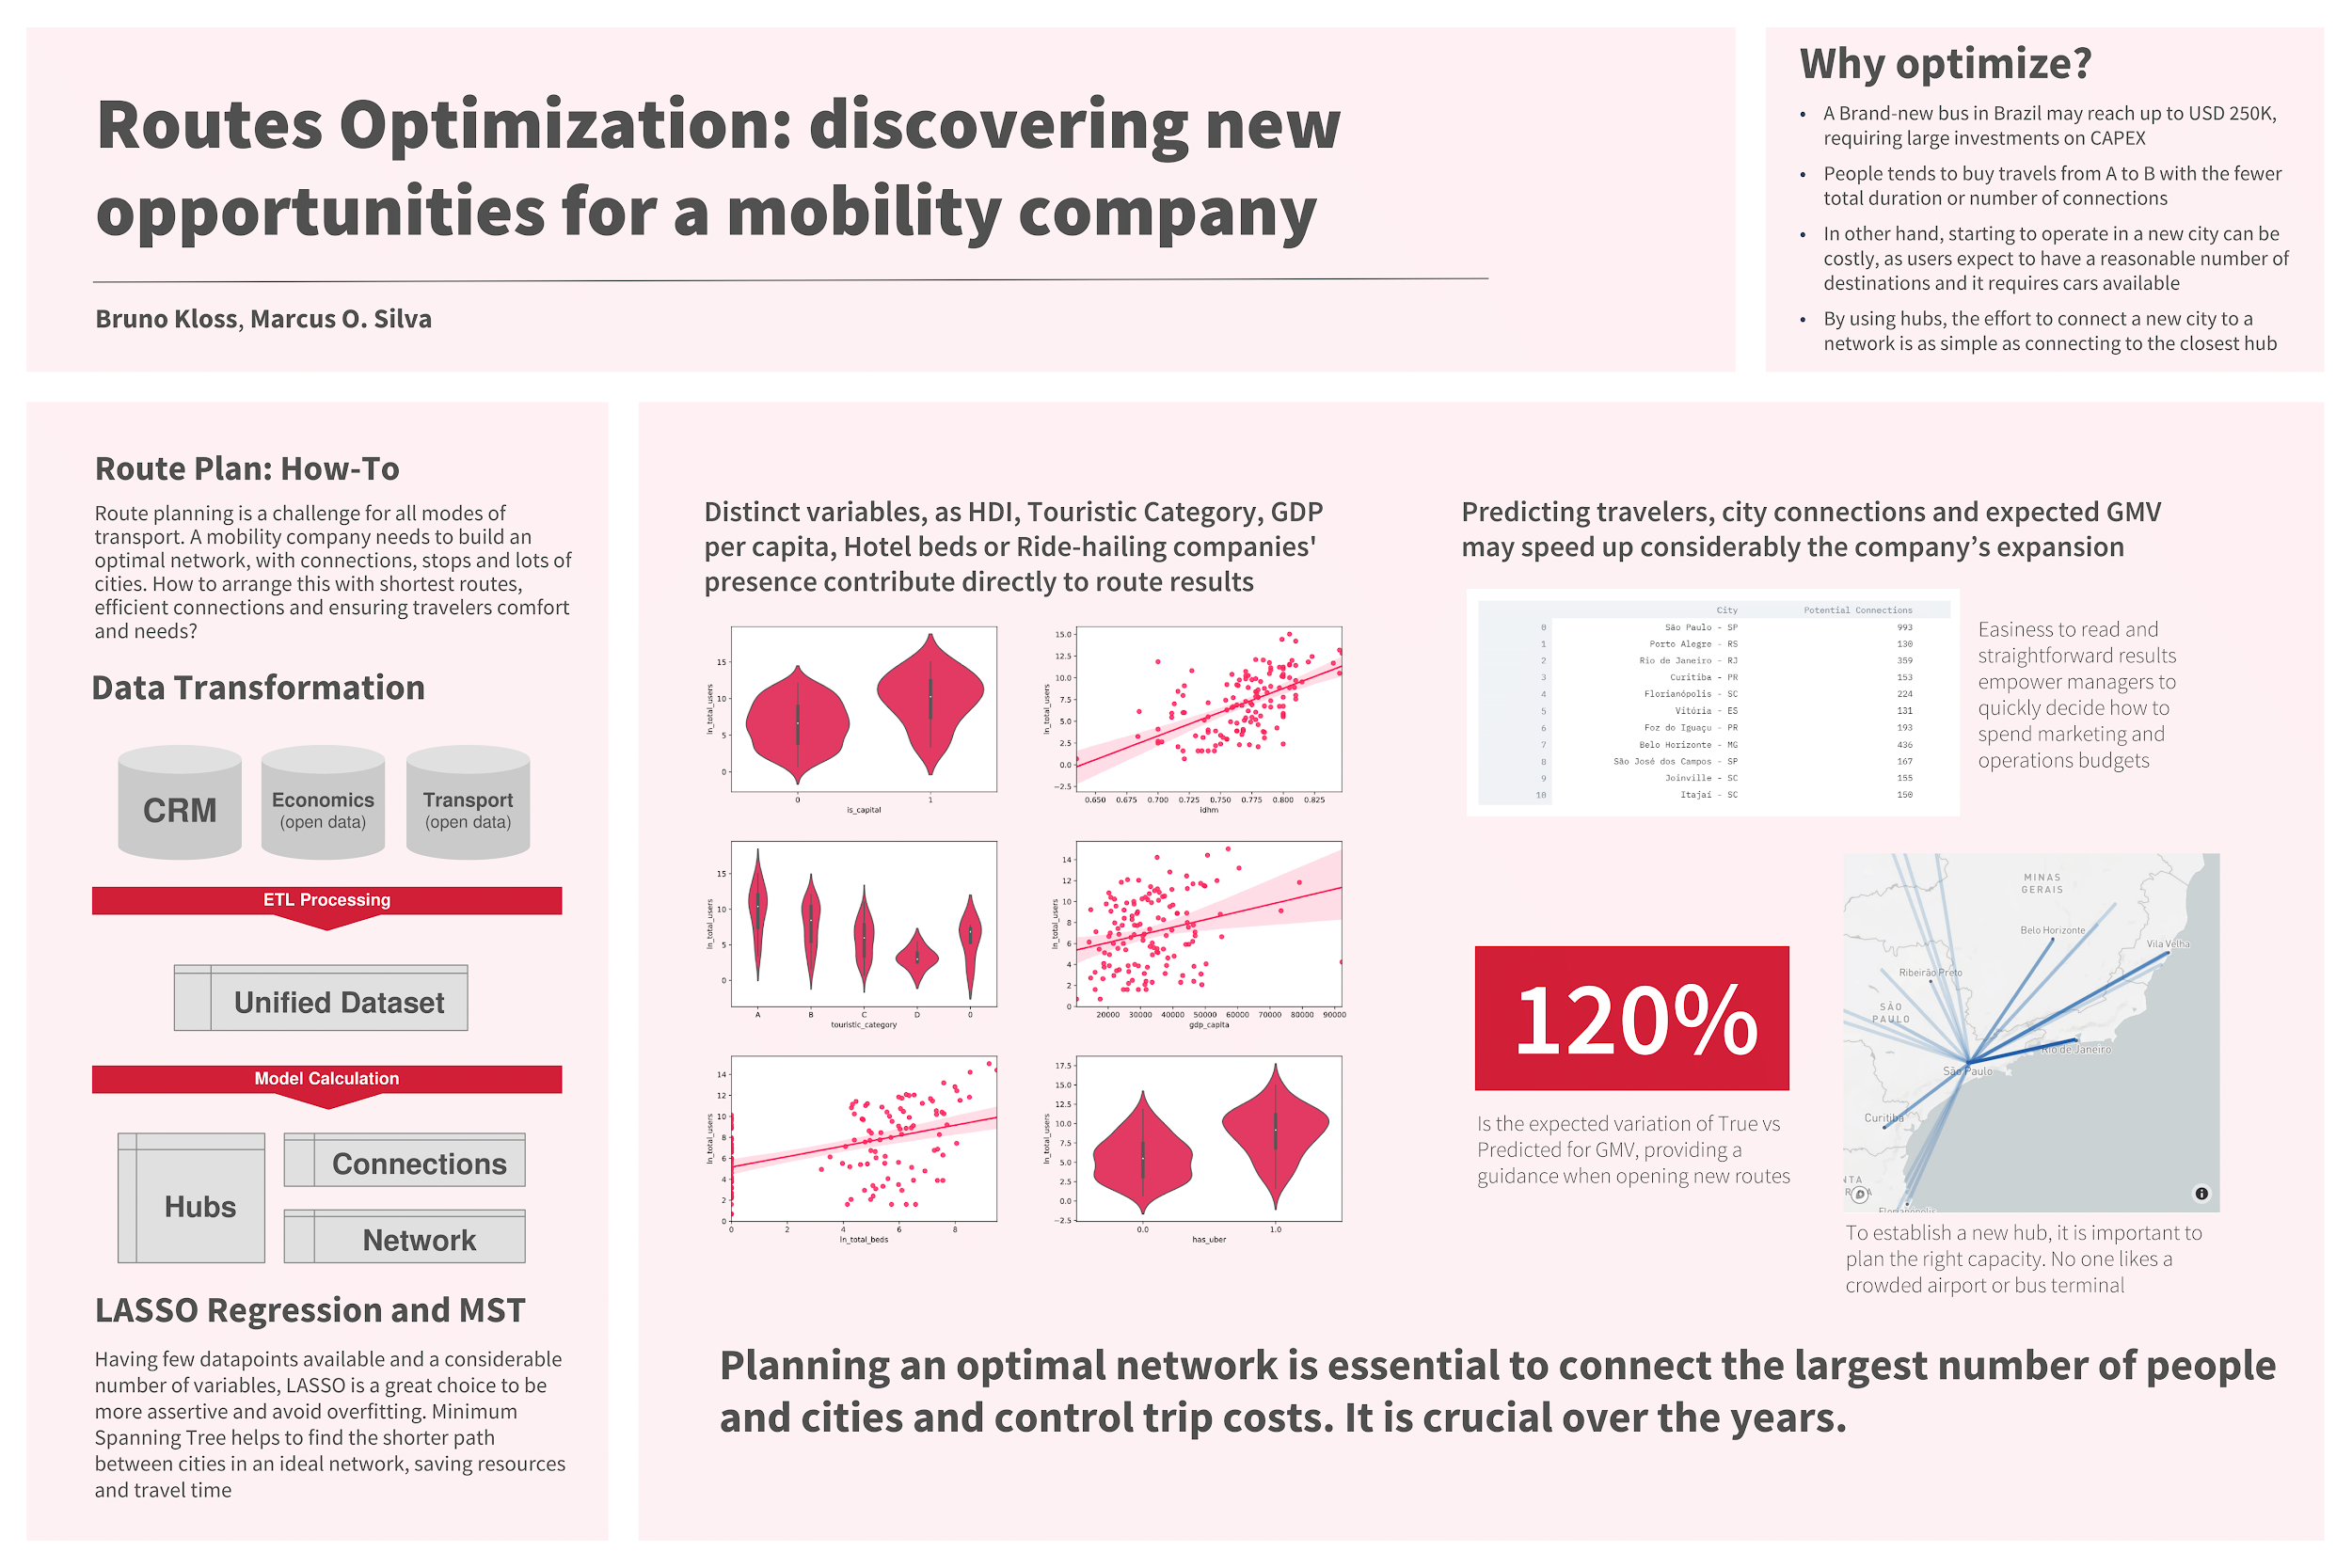
Add Visuals Charts, graphs, and maps are examples of great ways to tell your story

Slide 12
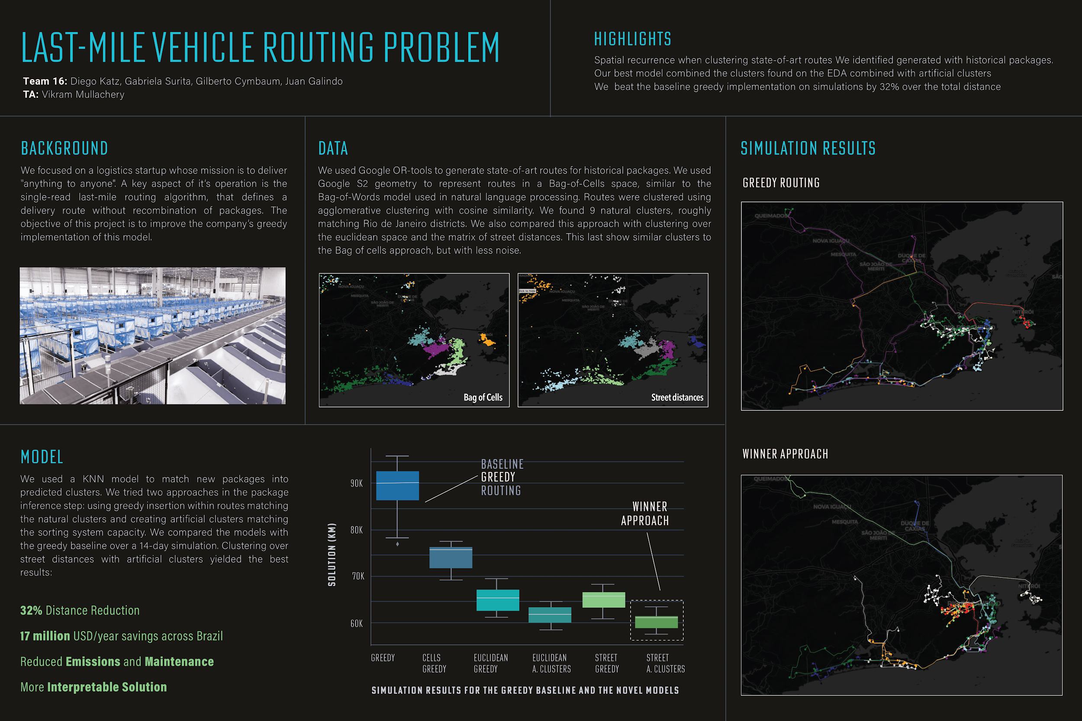
Tell a Story Focus on one narrative that you want to convey

Slide 13
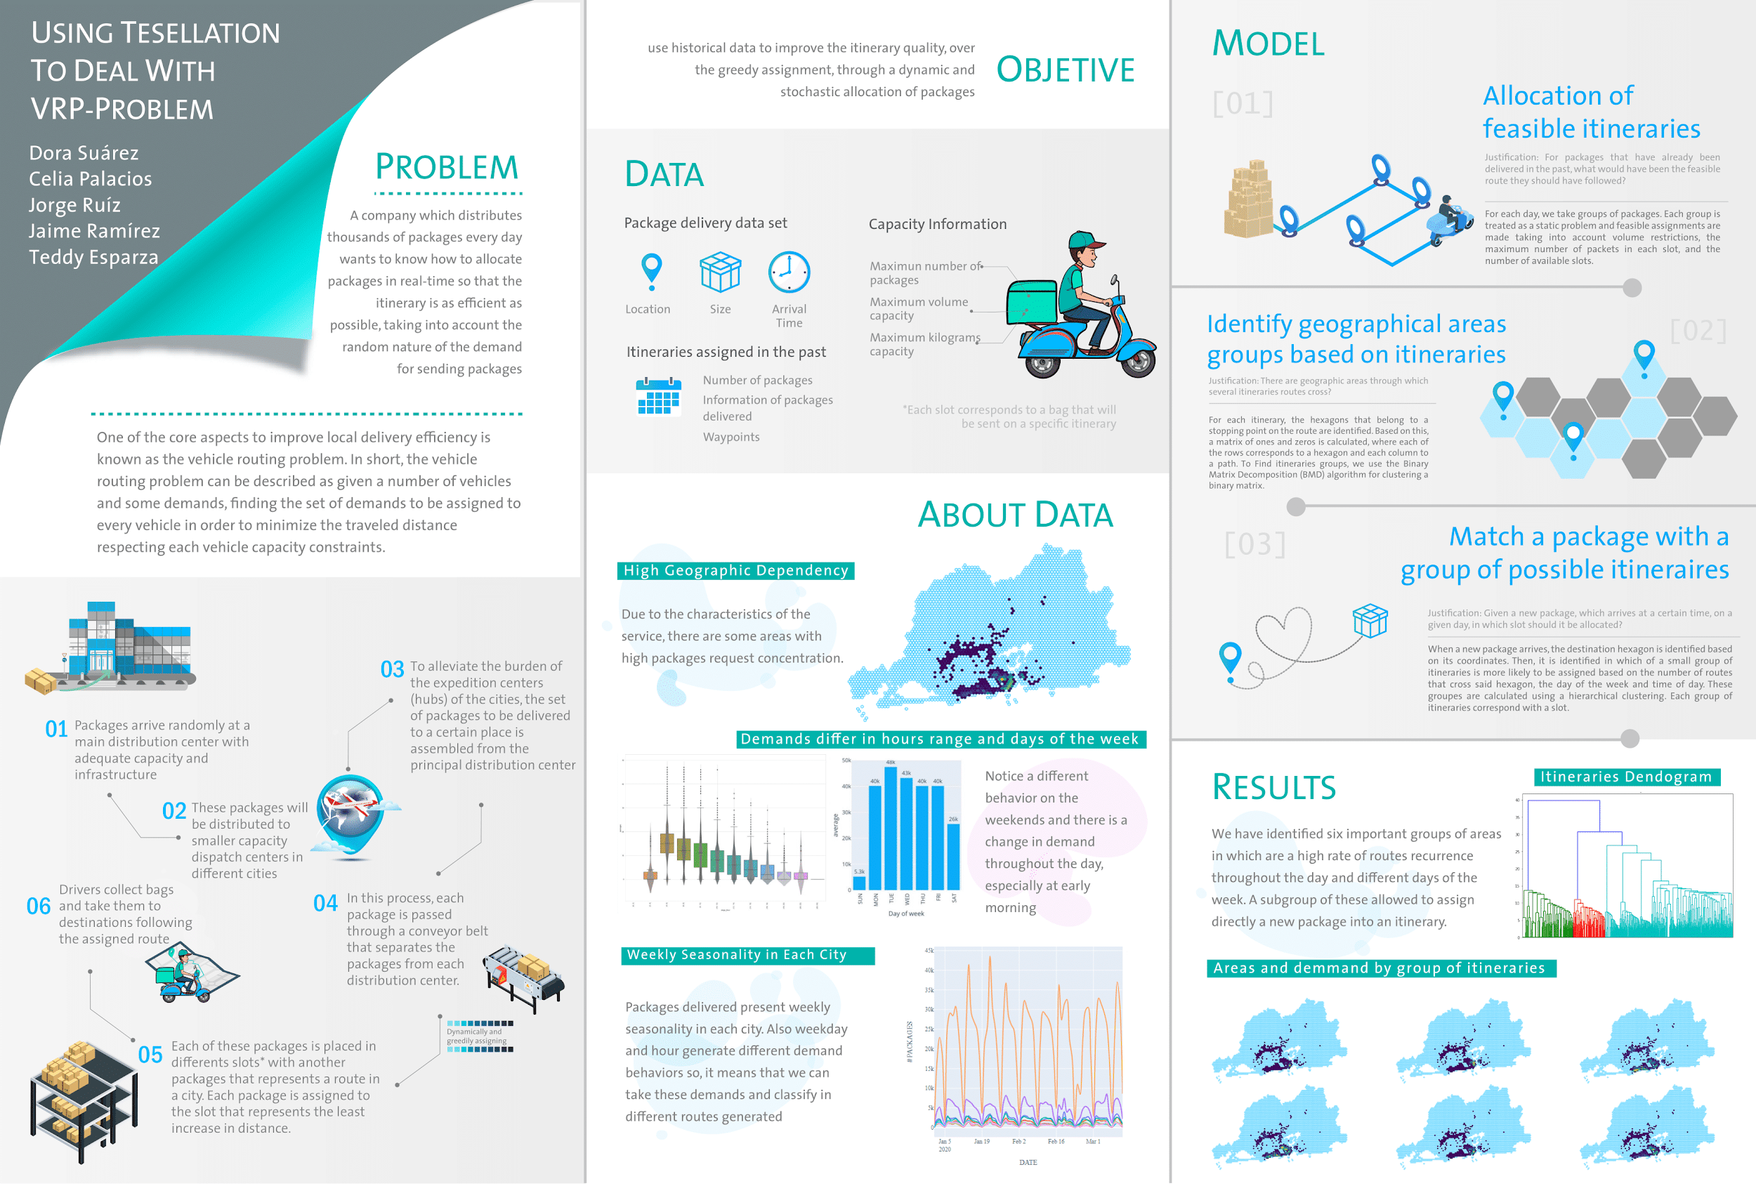
Make it Your Own Experiment with different layouts

Slide 14
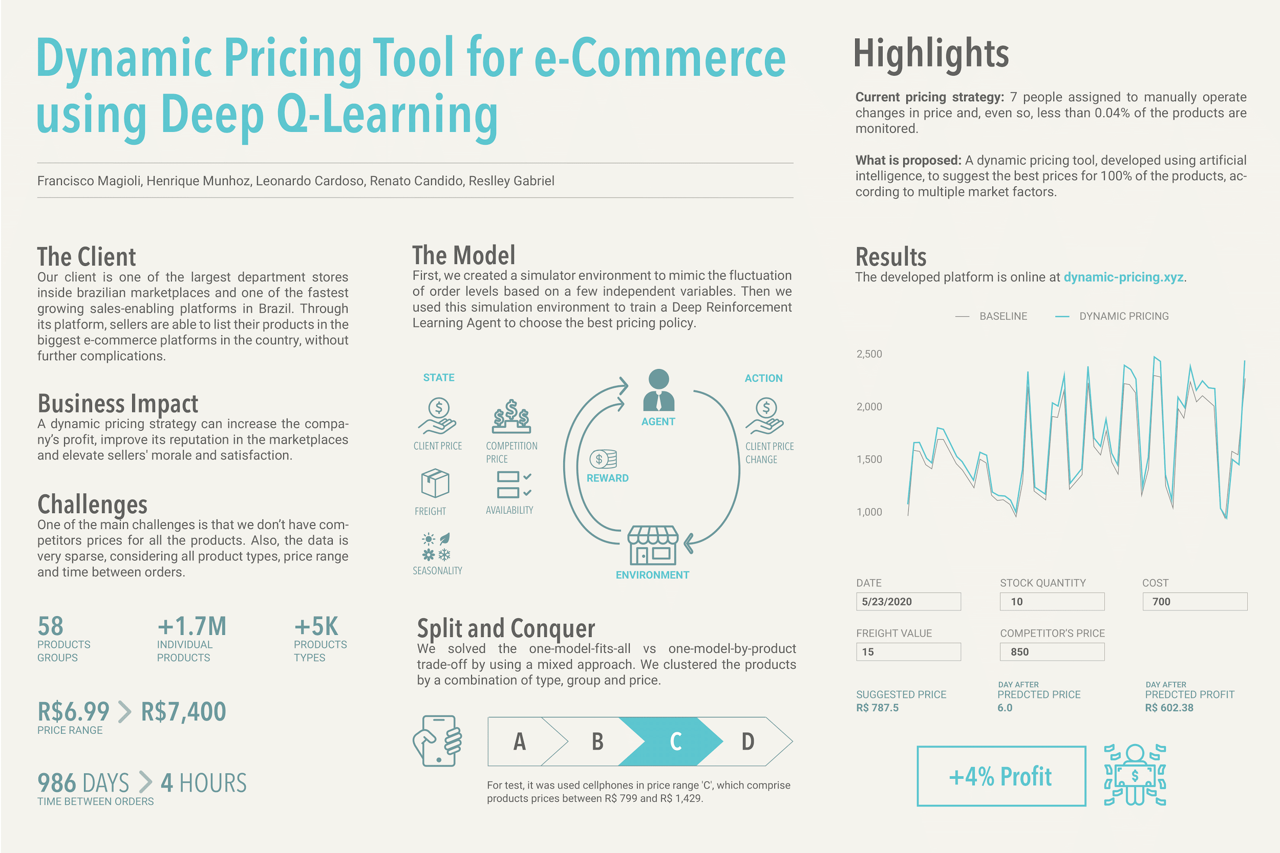
Keep it Simple Remember, you want a non-technical audience to understand it as well

